Slide 1
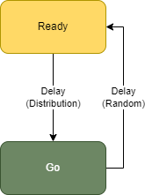
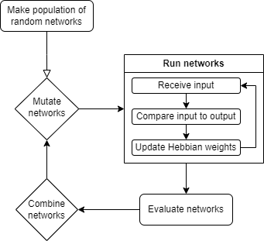
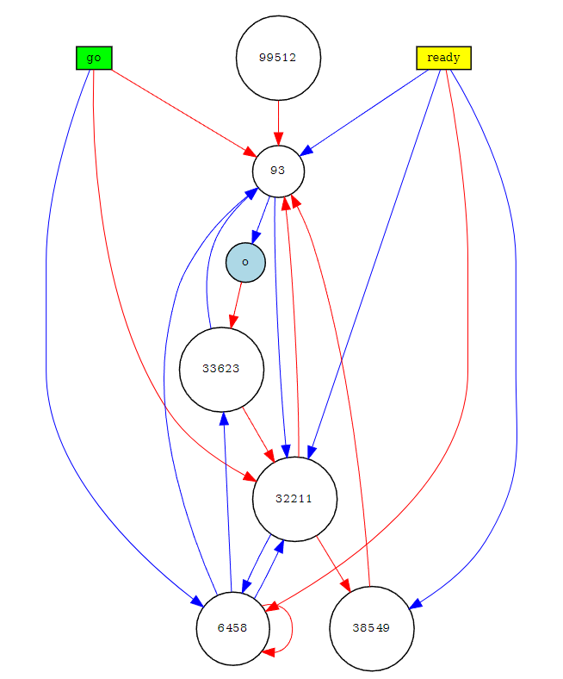
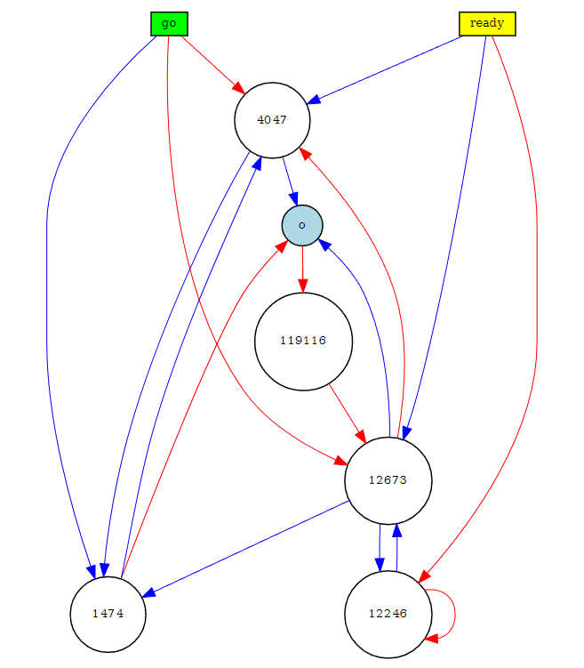
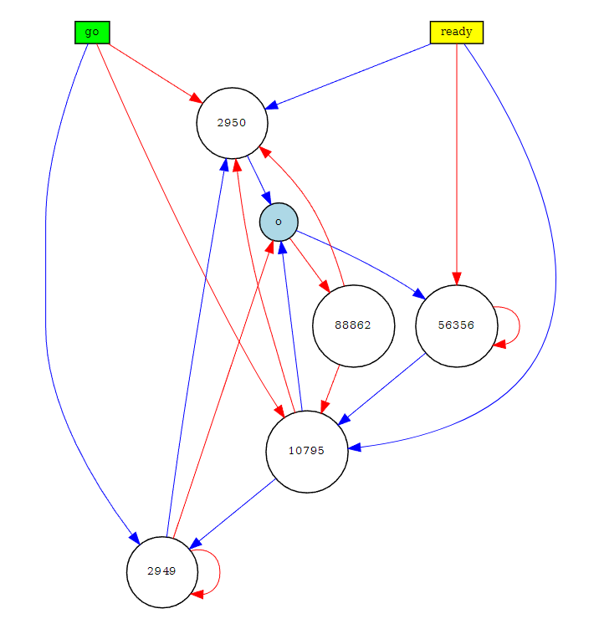
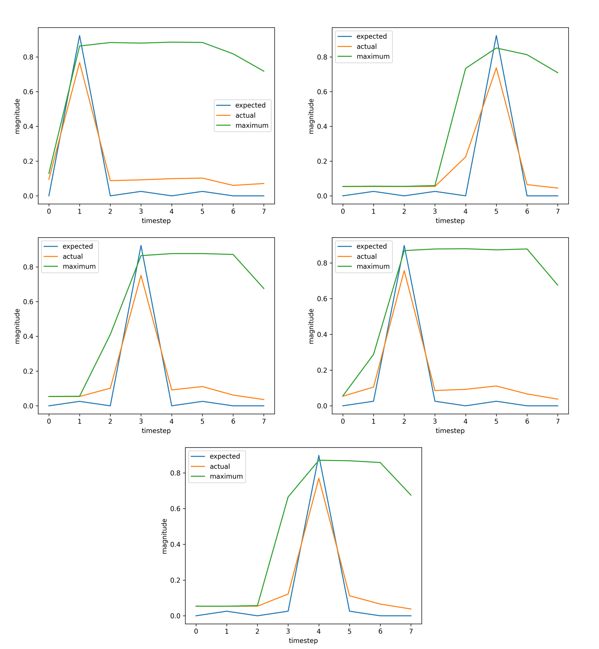
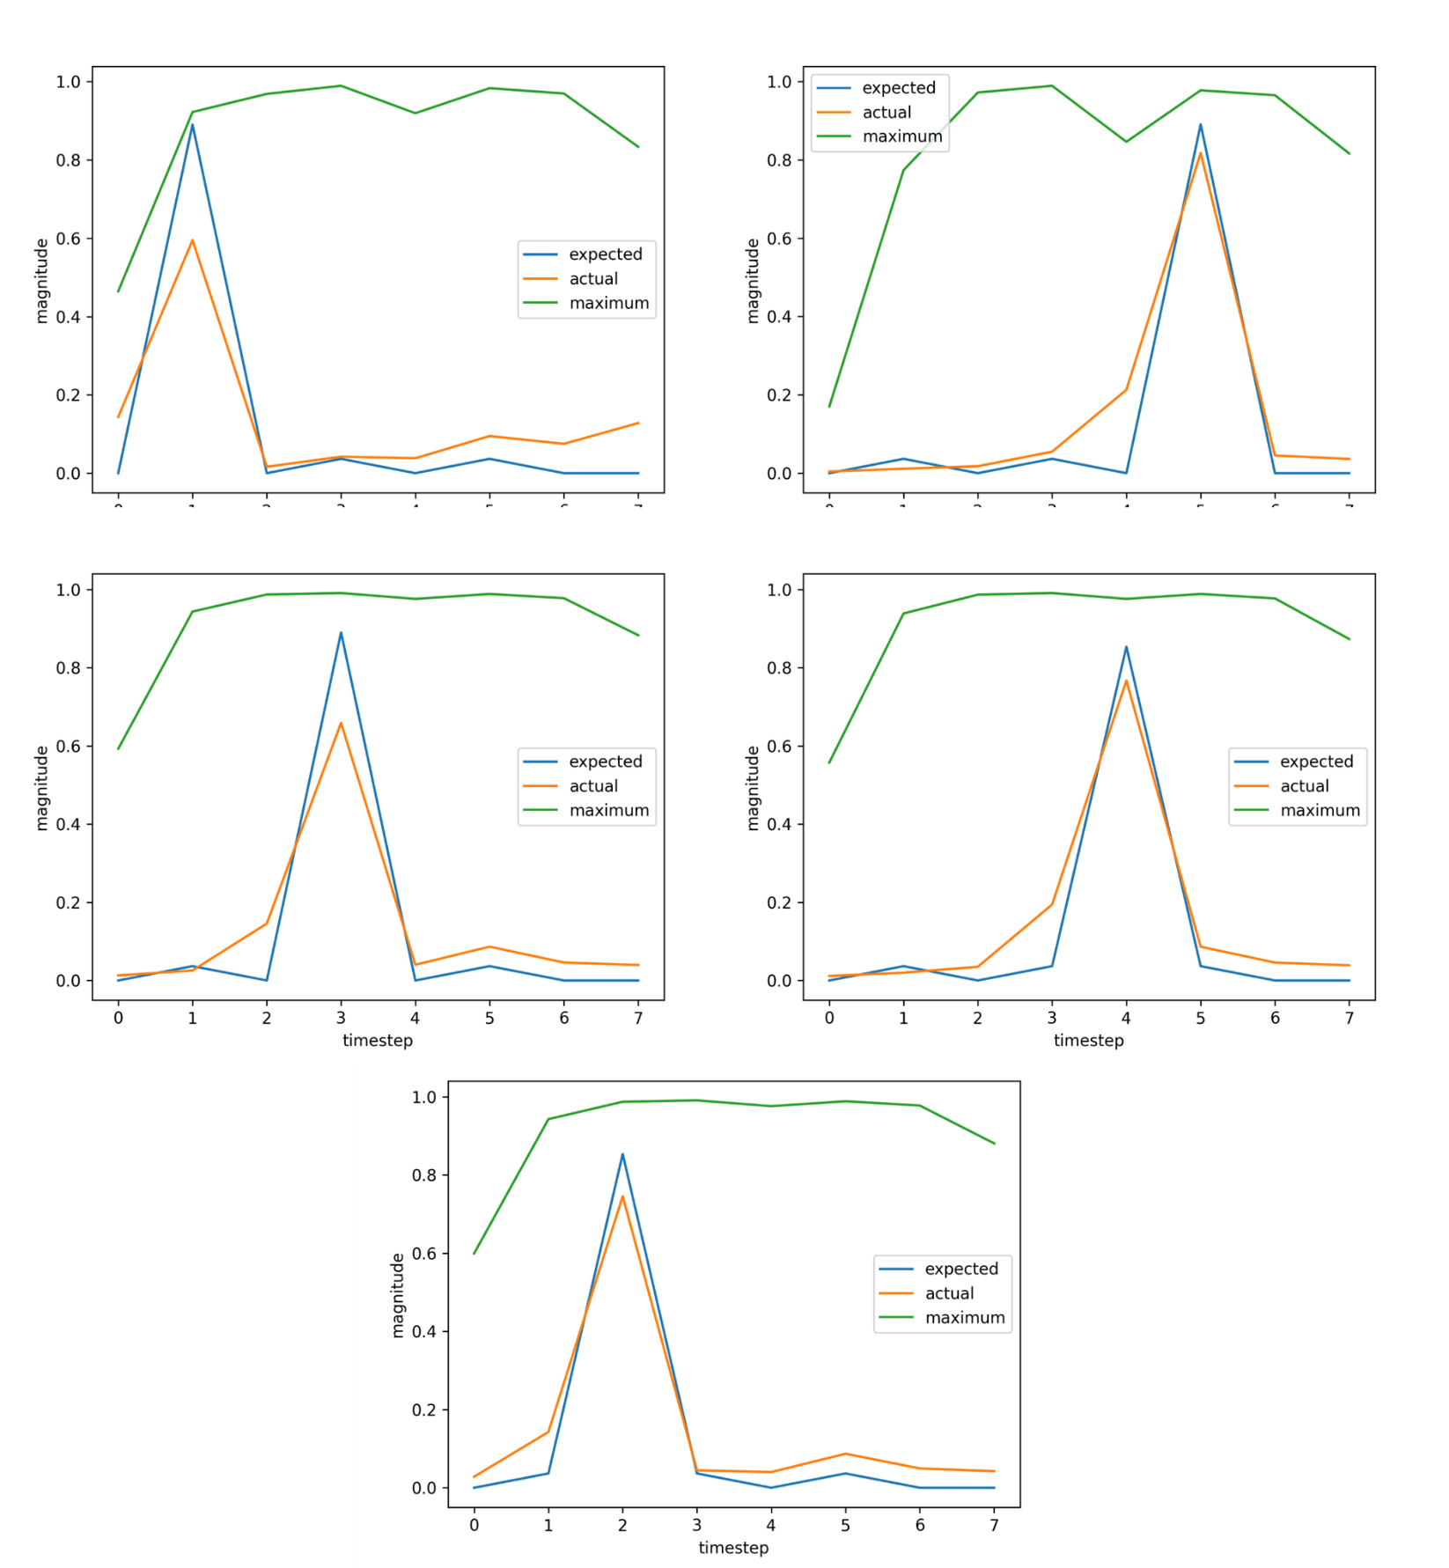
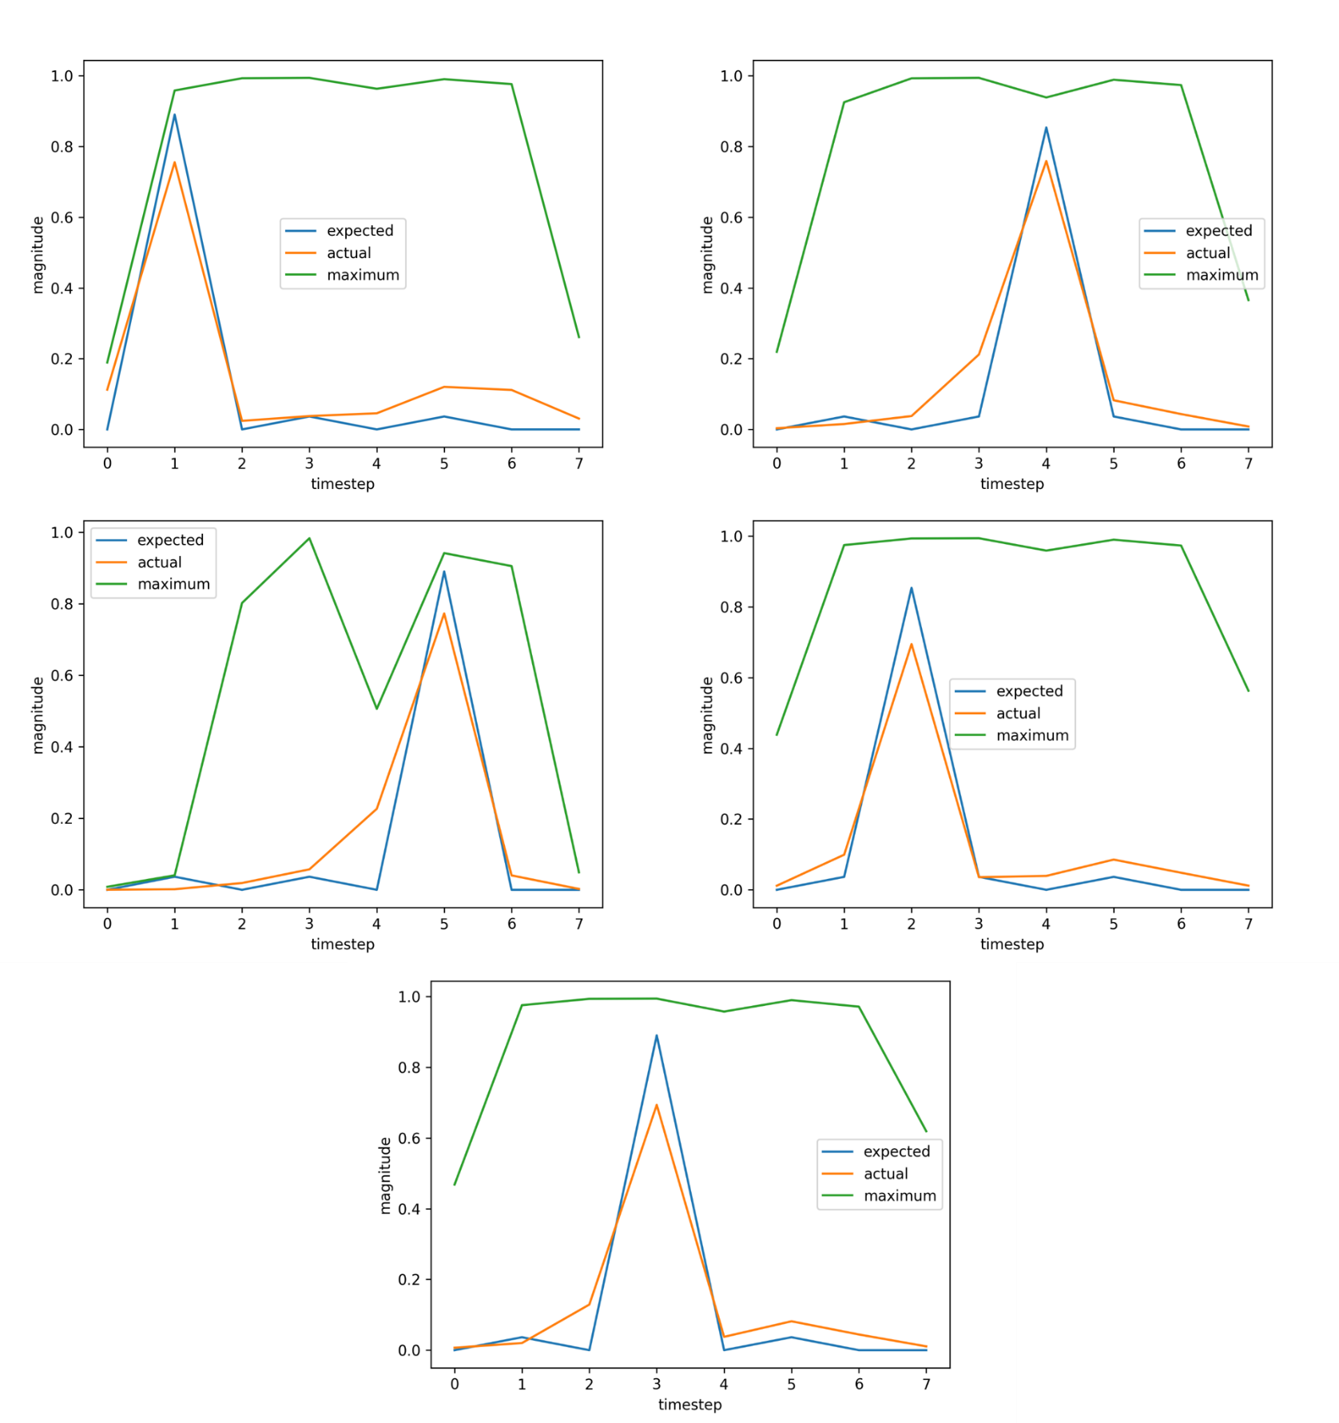
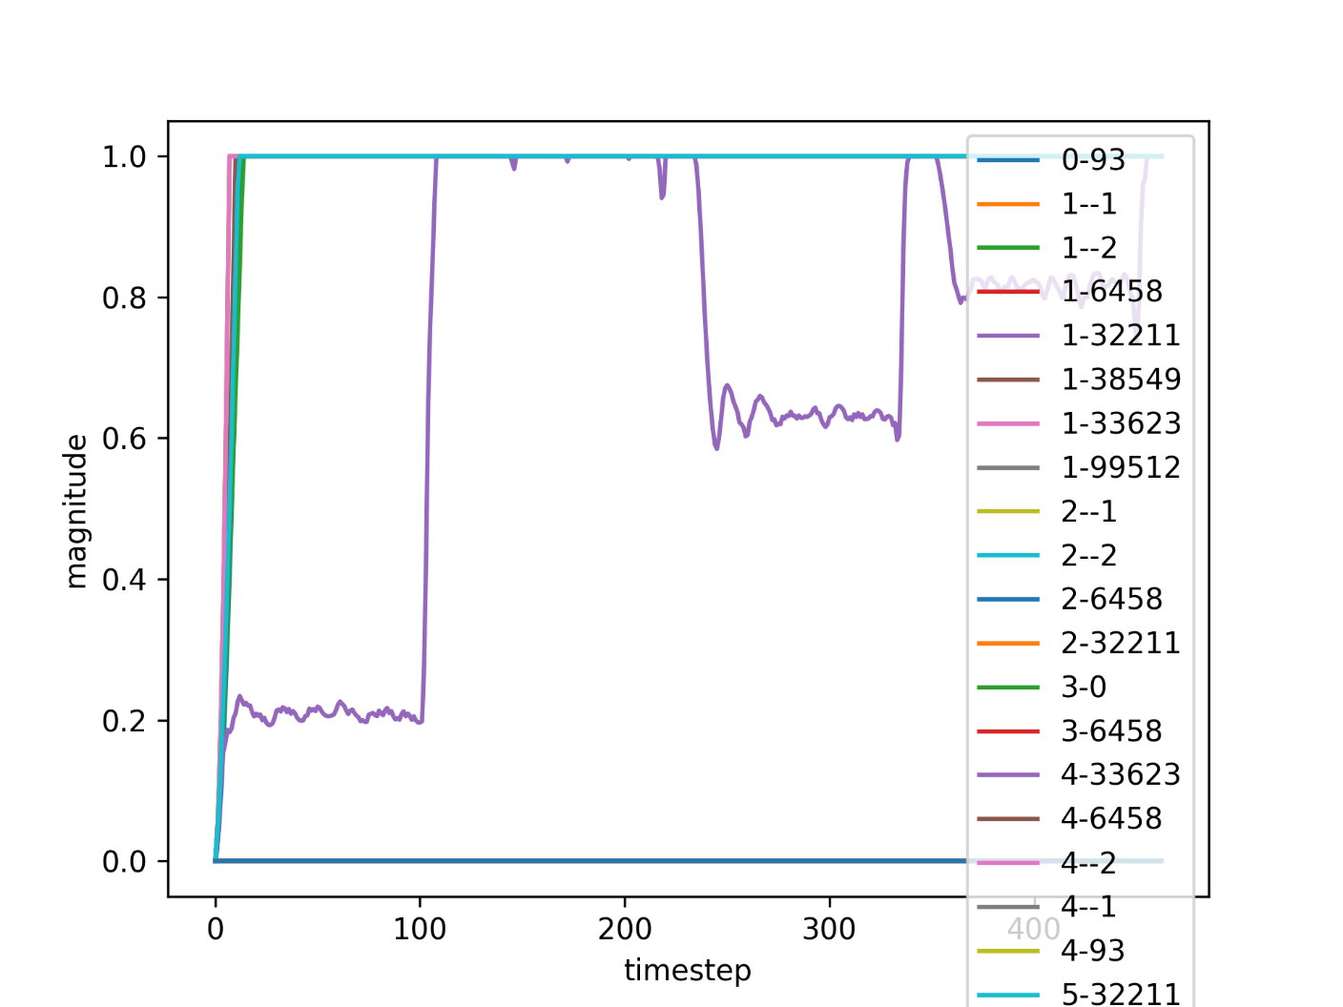
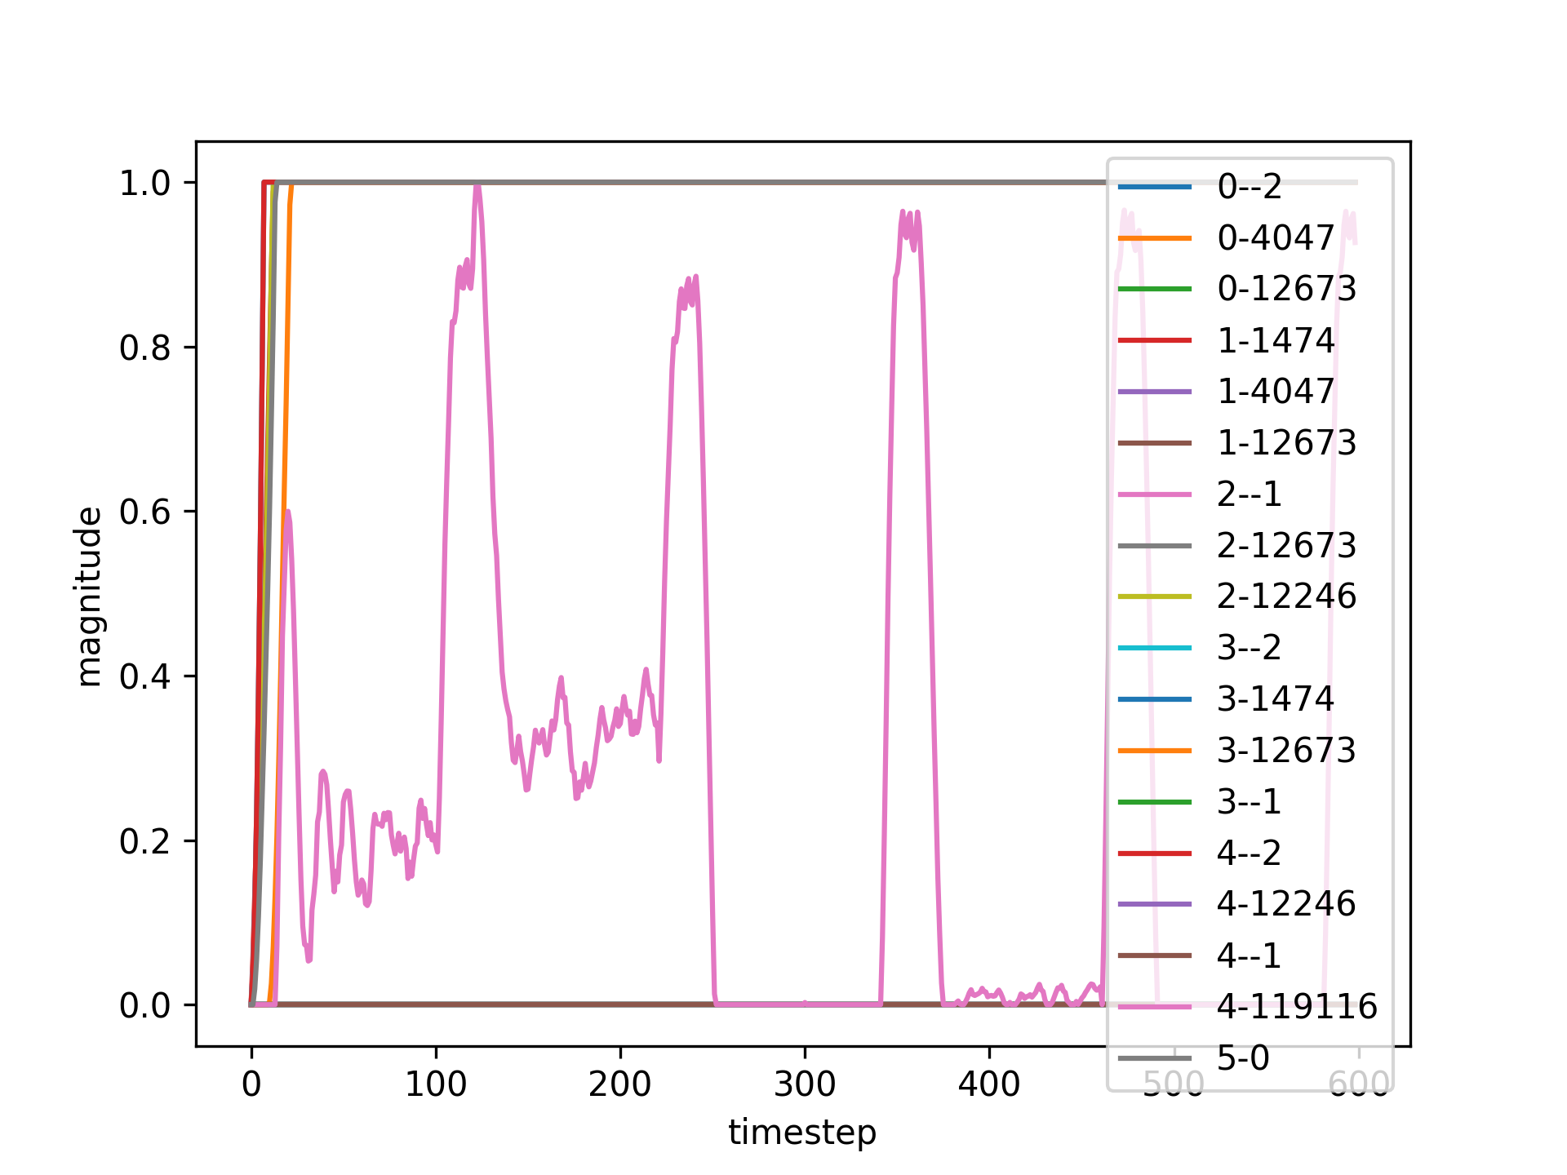
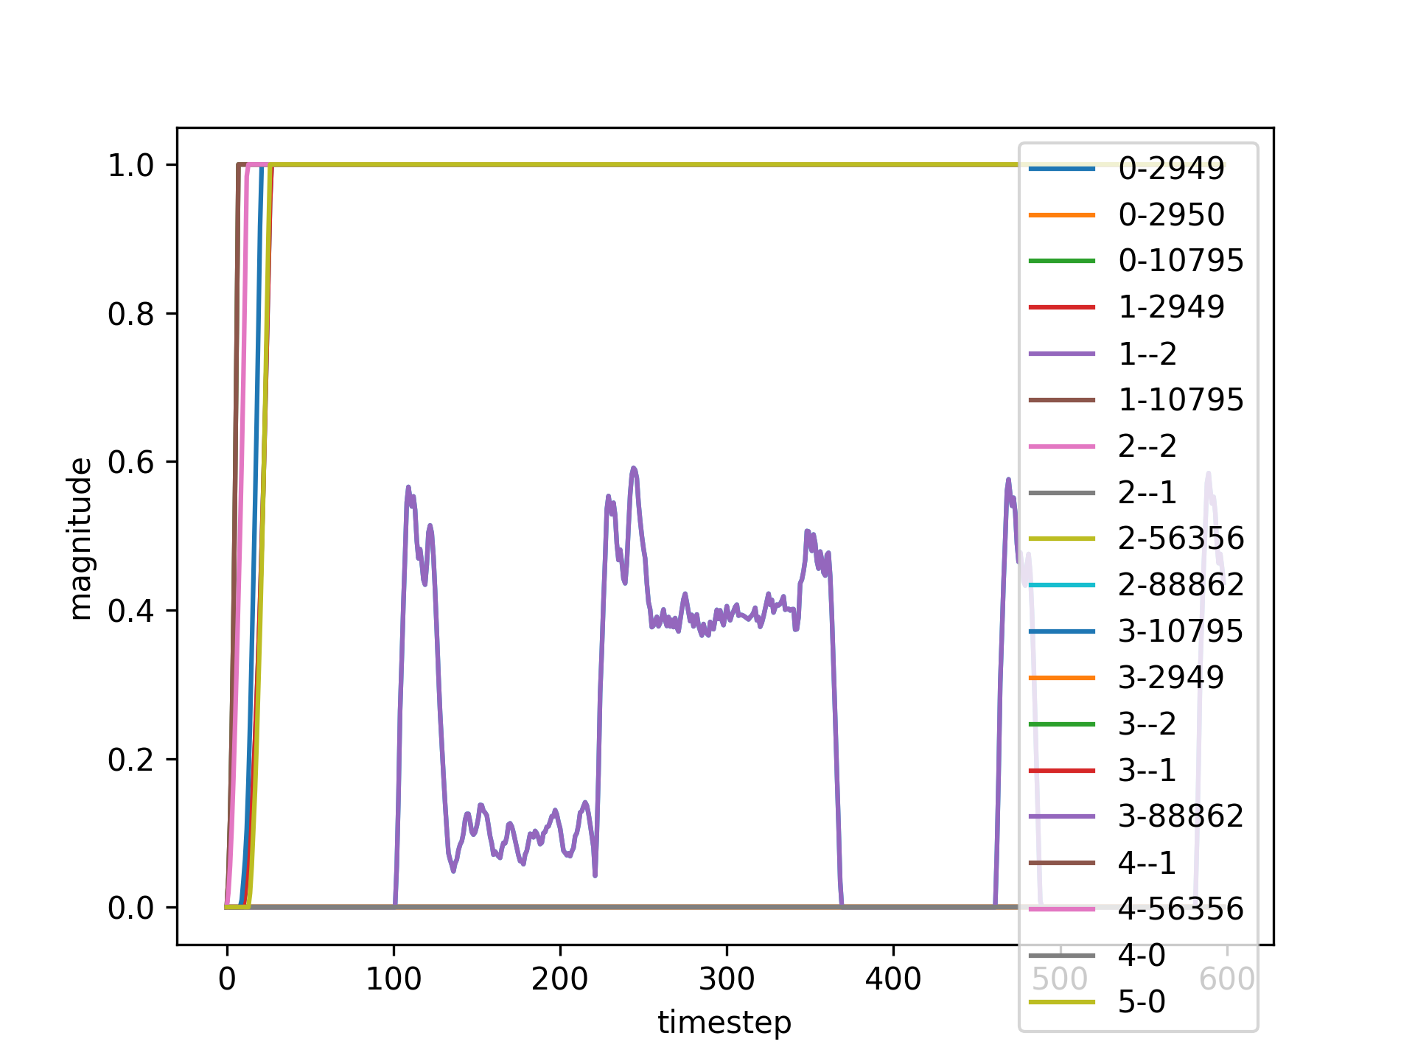
Evolving Biologically Plausible Networks for Temporal Prediction
Sondre H. Elgaaen, Felix B. Kern, Zenas C. Chao
Research Goals
Temporal Prediction
Biological Plausibility
Temporal prediction, a cognitive function critical for survival and decision-making, is an area of active research in the neuroscience world.
This work combines the neuroevolutionary NEAT algorithm with Hebbian learning to evolve forth biologically plausible networks capable of learning and adapting in an organic manner.
By utilizing neuroevolutionary techniques and biologically plausible learning methods, we hope to discover neural network structures that provide insight into how the brain performs the cognitive functions underlying temporal prediction.
Temporal prediction is the cognitive process by which the human brain anticipates future events based on historical data. By assimilating past experiences and contextual information, the brain can formulate predictive models of the environment, enhancing decision-making and planning processes. Efficient temporal prediction improves reaction times, facilitates the synchronization of actions with dynamic environments, and contributes significantly to skills like social interaction and communication by predicting others' behaviors or reactions.
The brain achieves temporal prediction through a complex, interconnected network of neurons that process past and present information to generate expectations about future occurrences. Although we know structures like the prefrontal cortex, hippocampus and cerebellum play a pivotal role in temporal prediction, we know little about the micro structures enabling these behaviors.
Biological plausibility in neural networks refers to AI models that mirror the brain's architecture and functions, enhancing both neuroscience research and AI robustness. Unlike traditional models prioritizing performance, biologically plausible networks emulate natural neural systems, providing insight into brain operations and improving AI adaptability and resilience. This synergy not only propels our understanding of the brain but also advances more sophisticated, brain-like AI systems.
NeuroEvolution of Augmenting Topologies (NEAT)
Ready-Go Task
NEAT is an evolutionary algorithm that generates artificial neural networks with topologies that evolve alongside network weights. It starts with simple networks and progressively complexifies them, selectively retaining beneficial structures over generations. By simulating natural evolutionary processes, NEAT can discover potent, often surprising, network architectures, making it particularly suitable for exploring biologically plausible neural networks. This method fosters networks capable of sophisticated behaviors and adaptive learning, akin to biological systems, without extensive human design input, reflecting the developmental capabilities of evolution.
By combining NEAT with Hebbian learning, we’re able to explore a wide array of potential network structures in an intelligent and efficient manner.
A simple timing-task aimed at developing networks whose only function is to encode the information needed to learn timings.
A Ready signal is sent to prepare the network for a coming Go signal, whose timing the network is made to predict. The fitness of the network is then evaluated at every time step by comparing the predicted and actual input of the network.
This process is repeated multiple times for different timings, with a random delay after each trial to ensure the network truly responds to the Ready signal
Hebbian Learning
Hebbian learning, often summarized by the phrase "neurons that fire together, wire together," is a neuroscientific theory describing one way synaptic plasticity can lead to learning. It postulates that if two neurons on either side of a synapse are activated simultaneously, the strength of that synapse increases. This form of learning is biologically plausible and is thought to underpin the development and adaptation of neural circuits in the brain.
By implementing a variant of Hebbian learning known as Spike-Timing Dependent Plasticity, the generated networks are able to utilize these concepts to learn in a biologically plausible manner.
Results
Fitness: 0.9900384252534866
Fitness: 0.9860429304685272
Fitness: 0.9877155236019718
awaiting results
Conclusion
Future Work
Acknowledgements
The evolved networks are well-performing, compact and biologically plausible. Combining NEAT and Hebbian learning shows promise as a good tool for finding networks that can give deeper insight into cognitive temporal functions.
However, although the networks are relatively simple for this problem domain, systems to ensure interpretability of the results will be needed for more complex problems.
There are still steps that can be taken to improve the biological plausibility of the networks, such as generating networks with signed nodes directly and converting to a Spiking Neural Network. Implementing motifs, or modular micro-networks that are repeated throughout solutions, is a natural next step for the interpretability of larger problem domains. Furthermore, a system to compare the found structures to substructures in the brain could improve empirical insights gained from the experiments.
For their academic, administrational and economic support, I thank the following:
Shoji Takeuchi, Kazuki Nishimoto and Morie Watanabe of the Takeuchi Lab
Yuri Marugata and Kaori Sato of the Office of International Relations
Fujiwara Kantaro of the IRCN
Pauline C. Haddow and Keith L. Downing of the Norwegian University of Science and Technology
Norwegian Ministry of Education and Research
Notes:
Add goal and conclusion
Conclusion?
“Structures can be learned”
“this or this is difficult”
“NEAT + Hebbian = good tool for finding biologically plausible topologies”
Rerun test for 12345-unordered-positive-dynamic-magnitude-hebbian-20-threshold-no-reset-2?

